Slide 1


PRESS DECK / EMBARGOED MATERIALS
A documentary investigation into the lies dividing American mothers
and the movement to bring them back together.
FROM CULTURE HOUSE / MOMS FIRST / FRENCH TUCK MEDIA / BOBBIE

Slide 2
02 / ABOUT THE FILM
THE FILM: NO COUNTRY FOR MOTHERS
“Motherhood in America is impossible by design.”
No Country for Mothers follows activist Reshma Saujani as she discovers the lies dividing American moms and chronicles a nationwide movement to bring them back together and win historic support.
THE AMERICAN MOTHERHOOD TOUR / PRESS DECK
02 ABOUT THE FILM

Slide 3
03 / SYNOPSIS
SAME FIGHT. NEW COSTUMES.
No Country for Mothers is a documentary investigation into the lies used throughout history to distract and divide American mothers.
The film opens on a simple truth: motherhood in America is impossible by design. Work ends at 6, but school pickup is at 3. Child care costs more than a paycheck. Some moms are back at work two weeks after giving birth. Moms aren't broken. The system is.
So why hasn't it changed? Because every time mothers get close to fixing it, someone hands them a culture war instead. Tradwife versus girlboss. Working mom versus stay-at-home mom. It's the same fight on repeat since the 1950s, just in new costumes. And it works, because the worst thing you can accuse a woman of is being a bad mother. So moms take the bait. They spend their energy defending their choices instead of demanding better ones. And while they fight each other, nothing changes.
No Country for Mothers traces that con through American history and travels the country to hear from the moms actually living it. Most don't want to milk a cow or hustle past their kids' bedtimes. They're just trying to get through the week without a sick kid or a broken car blowing up the budget.
The film is a call to move past manufactured divides and build an American motherhood that actually works, with the child care, paid leave, and real support moms have been promised and denied for decades.
THE AMERICAN MOTHERHOOD TOUR / PRESS DECK
03 SYNOPSIS

Slide 4

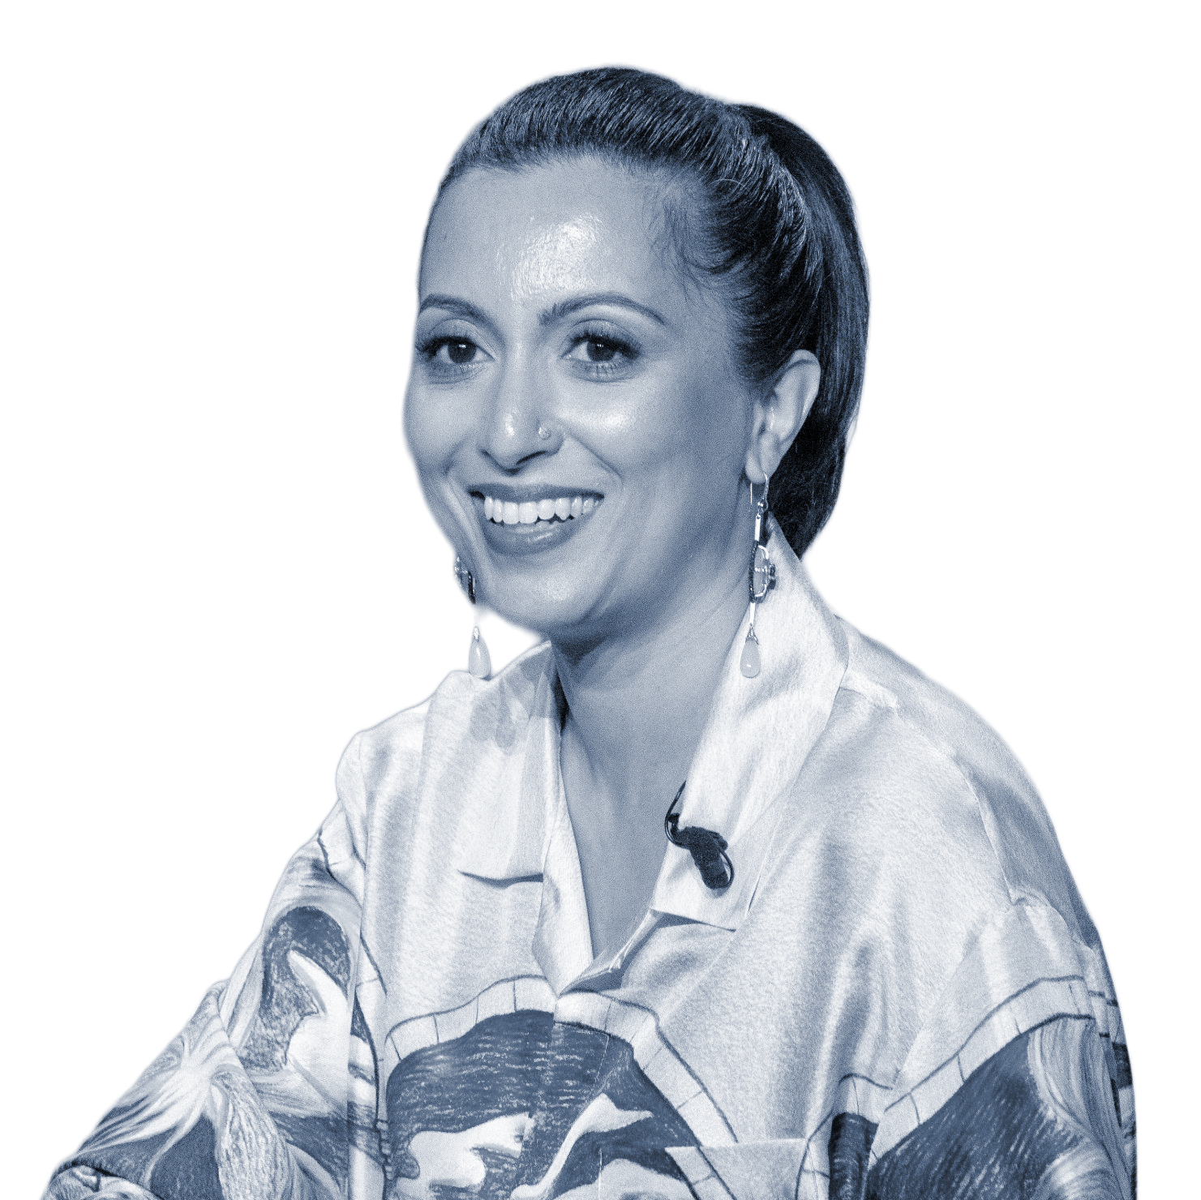

04 / THE FILMMAKERS
THE FILMMAKERS
PROTAGONIST + EXECUTIVE PRODUCER
DIRECTOR
EXECUTIVE PRODUCER
Reshma Saujani
Raeshem Nijhon
Tan France
Founder of Girls Who Code and Moms First. NYT bestselling author of Pay Up. Her TED talk has 54M+ views. Named a TIME Women of the Year and one of Forbes Most Powerful Women Changing the World.
Co-founder of Culture House. Emmy, NAACP, Critics Choice, IDA, Webby and Gotham nominated. Past work: Ladies First (Netflix), The Hair Tales (Hulu/Onyx), Black Twitter (Hulu), Everybody’s Fight. 2024 Ms. Foundation Women of Vision honoree.
Star of Netflix’s Queer Eye and co-host of Next in Fashion with Gigi Hadid. NYT bestselling author of Naturally Tan. Founder of French Tuck Media (2023), creating content that fosters community and transcends boundaries.
THE AMERICAN MOTHERHOOD TOUR / PRESS DECK
VISIT MOMSFIRST.US/DOC for a full list of Producers
04 THE FILMAKERS

Slide 5




05 / THE PRODUCERS
EXECUTIVE PRODUCERS
Moms First is a movement for America’s mothers. Launched during the COVID pandemic by Reshma Saujani, it's the leading national non-profit fighting for structural support like paid leave and affordable child care. The organization changes the narrative about American motherhood, influences decisionmakers, and wins historic workplace and policy change.
Culture House is a Black, Brown, and women-owned production company making premium nonfiction film and television. Founded in 2019 by Raeshem Nijhon, Carri Twigg, and Nicole Galovski, the team blends storytelling with cultural strategy. Their work has landed at Hulu, Netflix, Disney+, and beyond. Highlights include The Hair Tales with Tracee Ellis Ross and Oprah Winfrey, and Growing Up.
French Tuck Media is the production company founded by Tan France, the breakout star of Netflix's Queer Eye. French Tuck focuses on unscripted and documentary work. The mission is to tell stories that inspire community, humanity, and belonging. Tan’s dream is to rethink the familiar – to add a little surprise and a new, more global perspective to the content audiences keep coming back to.
Bobbie is the mom-founded, mom-led infant formula company shaking up an industry that has long shamed parents about how they feed their babies. Founded in 2018 by Laura Modi, Bobbie makes a clean, organic, European-style formula now used by hundreds of thousands of families. Beyond product, Bobbie is building a movement. They advocate publicly for paid leave and the dignity of every feeding choice.
THE AMERICAN MOTHERHOOD TOUR / PRESS DECK
05 EXECUTIVE PRODUCERS

Slide 6
06 / RELEASE PLAN
THE MOVEMENT IS ALREADY BUILDING
Thousands of moms have signed on to support the film and host screenings, setting a world record for the most producers on a single film.
At a moment when content about women is being suppressed or twisted into rage bait, No Country for Mothers is proof that women still have power, and they know how to use it, in the midterms and beyond.
No Country for Mothers premieres June 15 in New York City followed by a national screening tour with stops in Minneapolis, Chicago, San Francisco, and more than 1000 grassroots screenings hosted by moms and allies in all 50 states timed to America’s 250th Anniversary.
Anyone can sign up to host a screening at MomsFirst.Us.
THE AMERICAN MOTHERHOOD TOUR / PRESS DECK
06 RELEASE PLAN

Slide 7
07 / RELEASE PLAN
SETTING THE World Record
The record-setting producer credit reflects the film’s central premise: that motherhood in America is not a private struggle but a collective one.
More than 2,500 mothers, caregivers, and advocates signed on to support the film, share their story, and host a screening. Their names will appear in the film’s final credits.
This beats the previous world record of 1,468 producers held since 1991 by the Japanese film Senso to Seishin.
With this world record, No Country for Mothers turns its production into a movement.
THE AMERICAN MOTHERHOOD TOUR / PRESS DECK
07 RELEASE PLAN

Slide 8
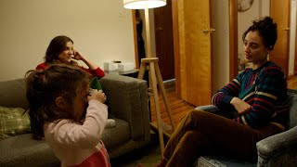
08 / ASSETS
CREATIVE ASSETS: TEASER
Vertical & horizontal video available for download in this folder
Source: Moms First
THE AMERICAN MOTHERHOOD TOUR / PRESS DECK
08 CREATIVE ASSETS

Slide 9

09 / ASSETS
CREATIVE ASSETS: TRAILER
Vertical & horizontal video available for download in this folder
Source: Moms First
THE AMERICAN MOTHERHOOD TOUR / PRESS DECK
09 CREATIVE ASSETS

Slide 10
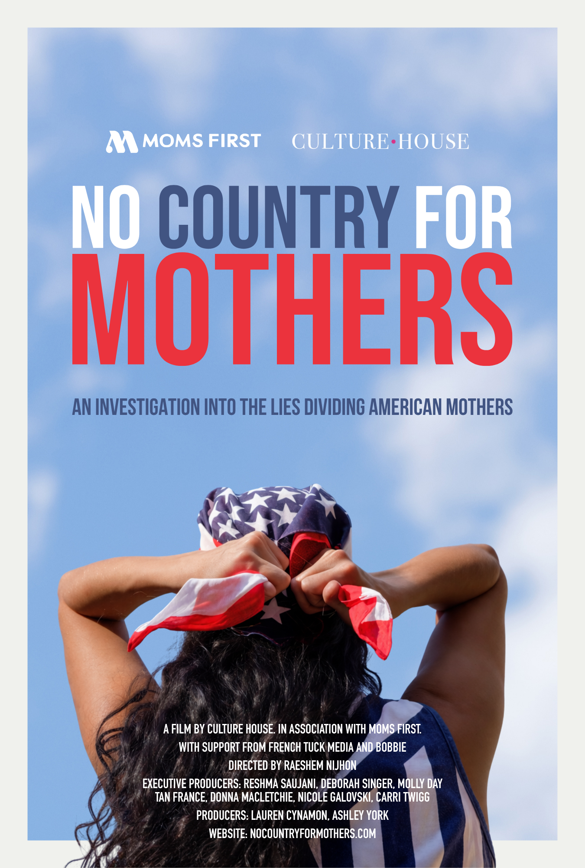
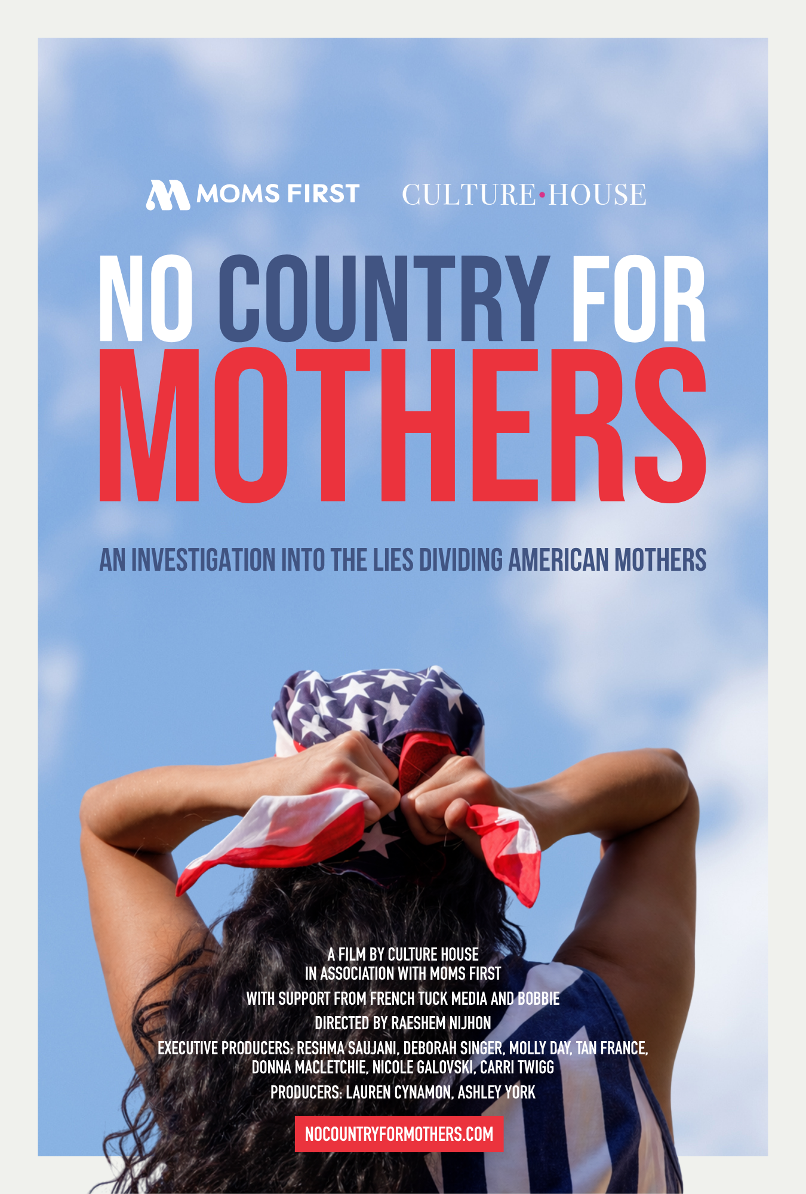
10 / ASSETS
CREATIVE ASSETS: ART
Available for download in this folder
Source: Moms First
THE AMERICAN MOTHERHOOD TOUR / PRESS DECK
10 CREATIVE ASSETS

Slide 11

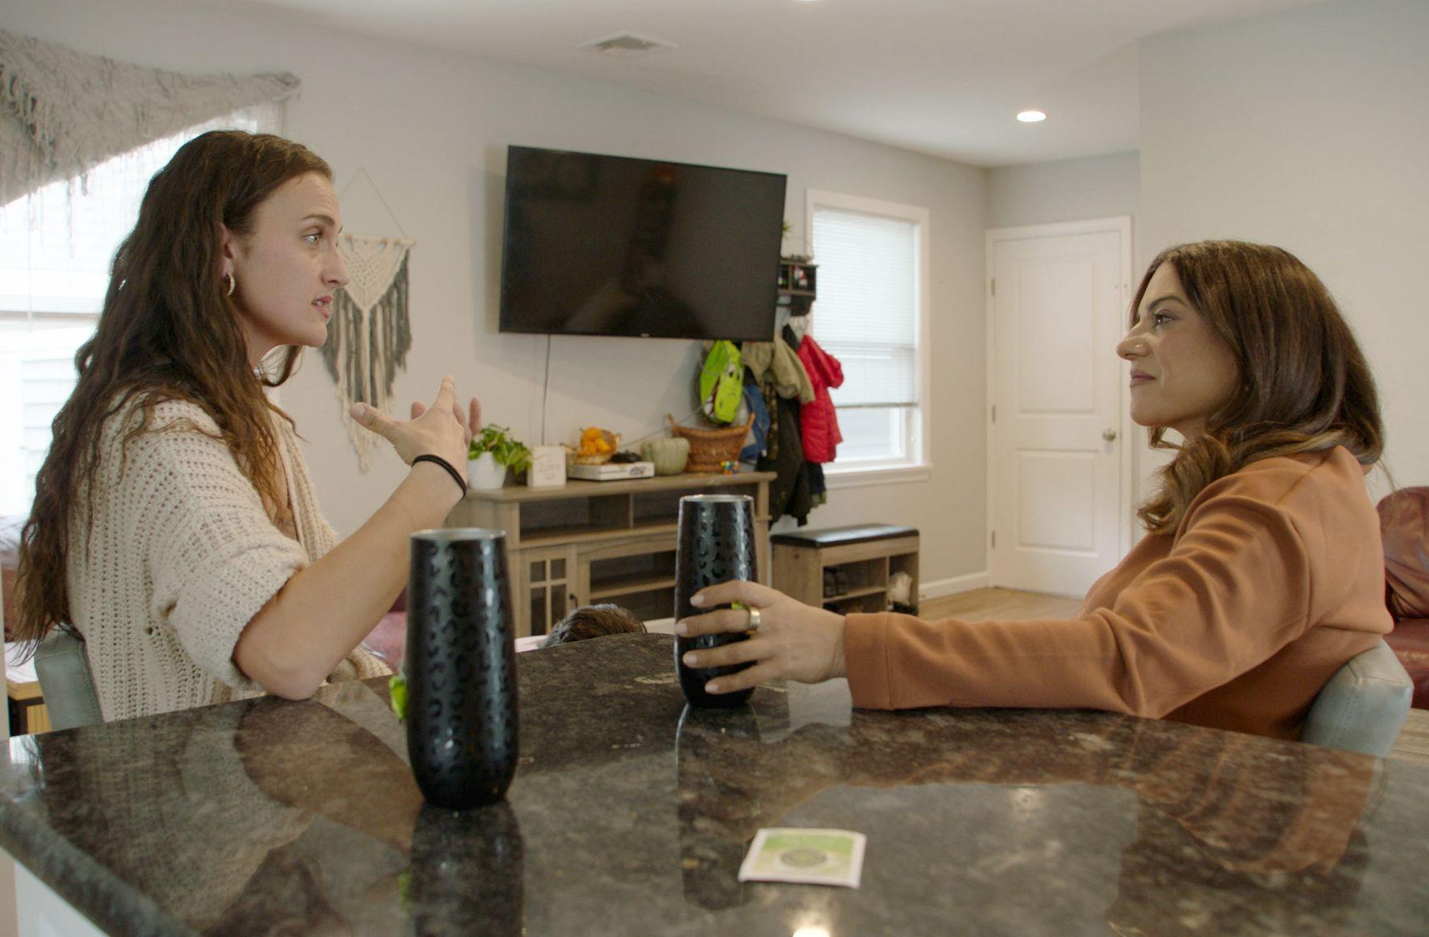
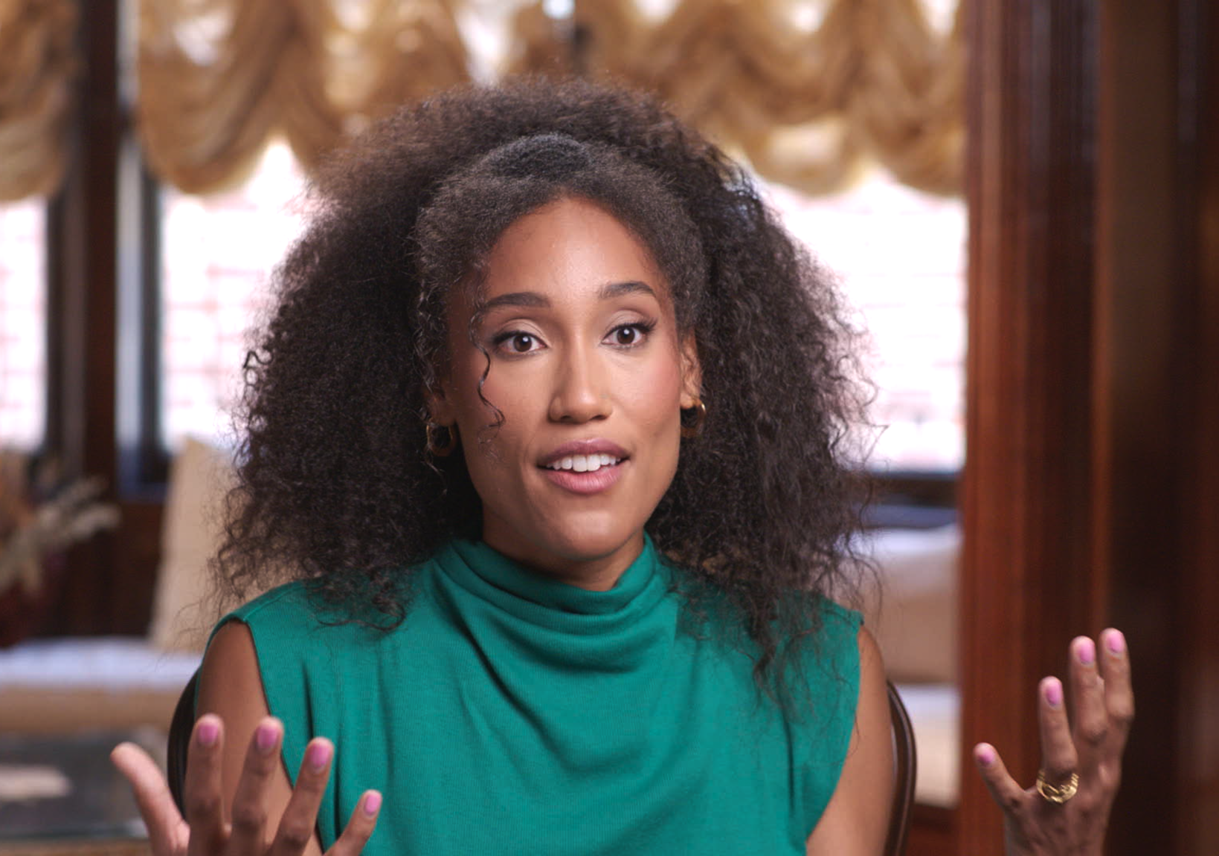
11 / ASSETS
CREATIVE ASSETS: FILM STILLS
Multiple production stills available for download in this folder
Source: Moms First
THE AMERICAN MOTHERHOOD TOUR / PRESS DECK
11 CREATIVE ASSETS

Slide 12
12 / FAQs
FREQUENTLY ASKED QUESTIONS
Q.01
Q.02
How do I watch the film?
What is the film about?
The film premieres on June 15th and is meant to be watched in community. Sign up to host a screening or join a public screening at MomsFirst.us.
A documentary investigation into the lies used throughout history to distract and divide American mothers, following Reshma Saujani as she chronicles a movement to bring them back together and win real support.
Q.03
Q.04
Why did you make the film?
What can I do after watching?
To investigate the lies used throughout American history to distract and divide moms, so we can finally win the support they need: child care, paid leave, and real backing.
The film is meant to build a movement, not end one. Host a screening at MomsFirst.Us. Vote in the midterms. And tell every mom you know that she is not alone, and that we are organized. The fight for paid leave and child care is winnable. We just have to show up.
THE AMERICAN MOTHERHOOD TOUR / PRESS DECK
12 FAQs

Slide 13
PRESS CONTACT
Let’s Tell This Story
press@momsfirst.us
For interview requests, asset access, and screening logistics.
THE AMERICAN MOTHERHOOD TOUR

